Slide 1
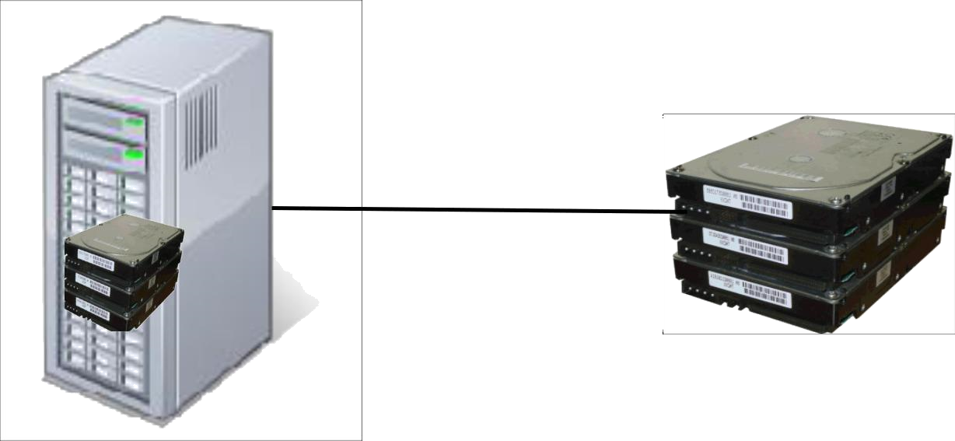
What is Elastic Block Store (EBS)?
Instance | EBS storage
EBS storage is allocated in volumes
A volume is a 'virtual disk' (size: 1gb – 16tb)
Basically, a raw block device
Can be attached to an instance (but only one at a time)
A single instance can access multiple volumes
Placed in specific availability zones
Why is this useful?
Be sure to place it near instances (otherwise can't attach)
Replicated across multiple servers
Data is not lost if a single server fails
Amazon: Annual failure rate is 0.1-0.2%

Slide 2
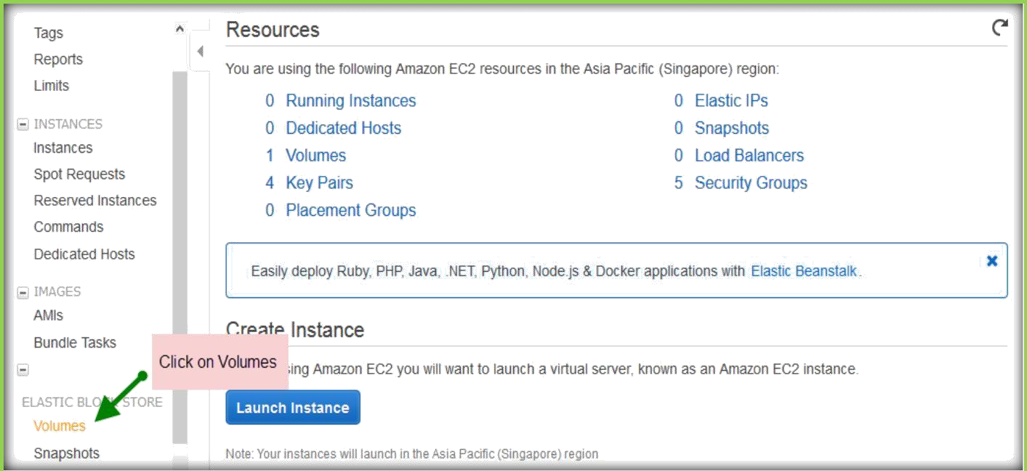
EC2 instances can have an EBS volume as their root device ("EBS boot")
Result: Instance data persists independently from the lifetime of the instance
You can stop and restart the instance, like suspending and resuming a laptop
▪
You won't be charged for the instance while it is stopped (only for EBS)
o You can enable termination protection for the instance
▪
Blocks attempts to terminate the instance (e.g., by accident) until termination protection is disabled again
CREATE EBS VOLUMES
Once you are in the EC2 page, click Volumes under ELASTIC BLOCK STORE on the left pane.

Slide 3
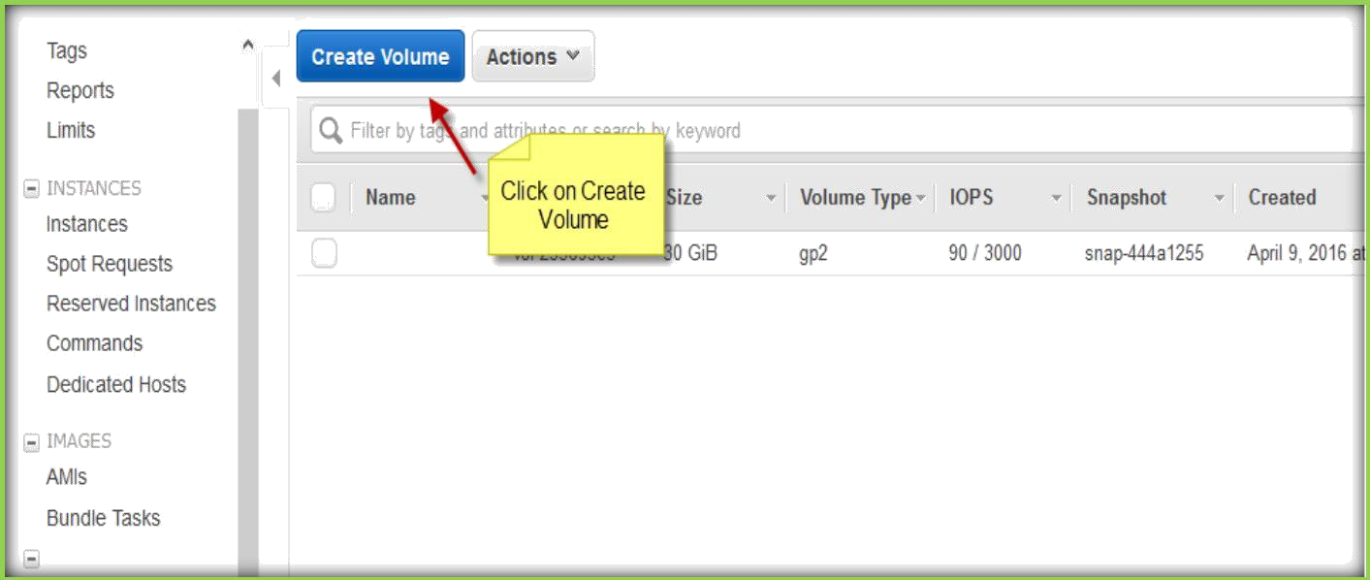
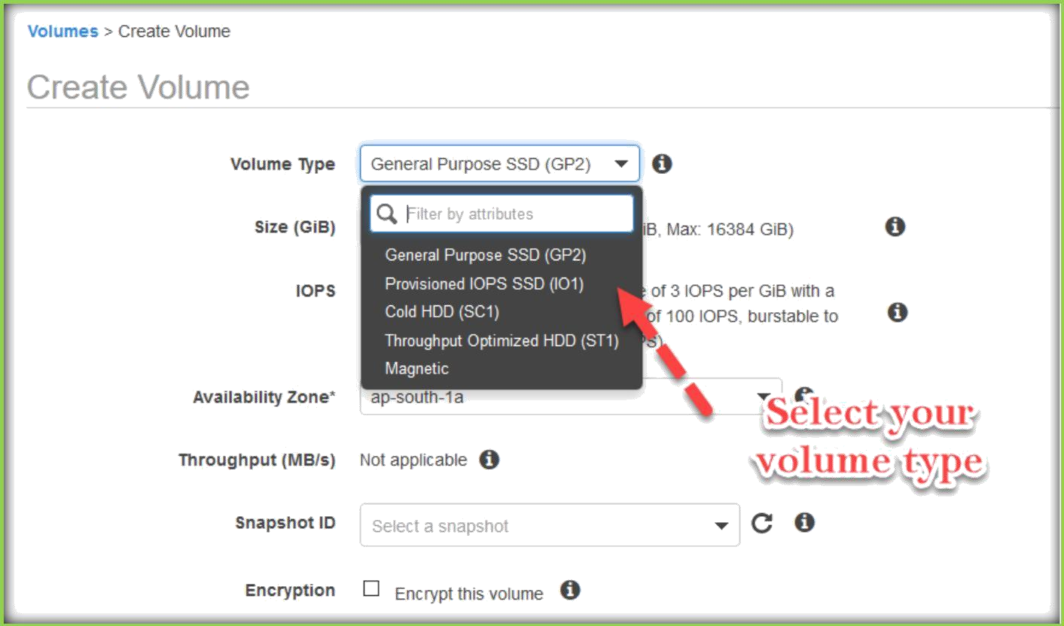
Once you are in the Volumes page, click on Create Volume to create a new volume.
A pop-up window will come and there you need to specify the volume specifications.
Select Volume Type from the drop-down list.

Slide 4
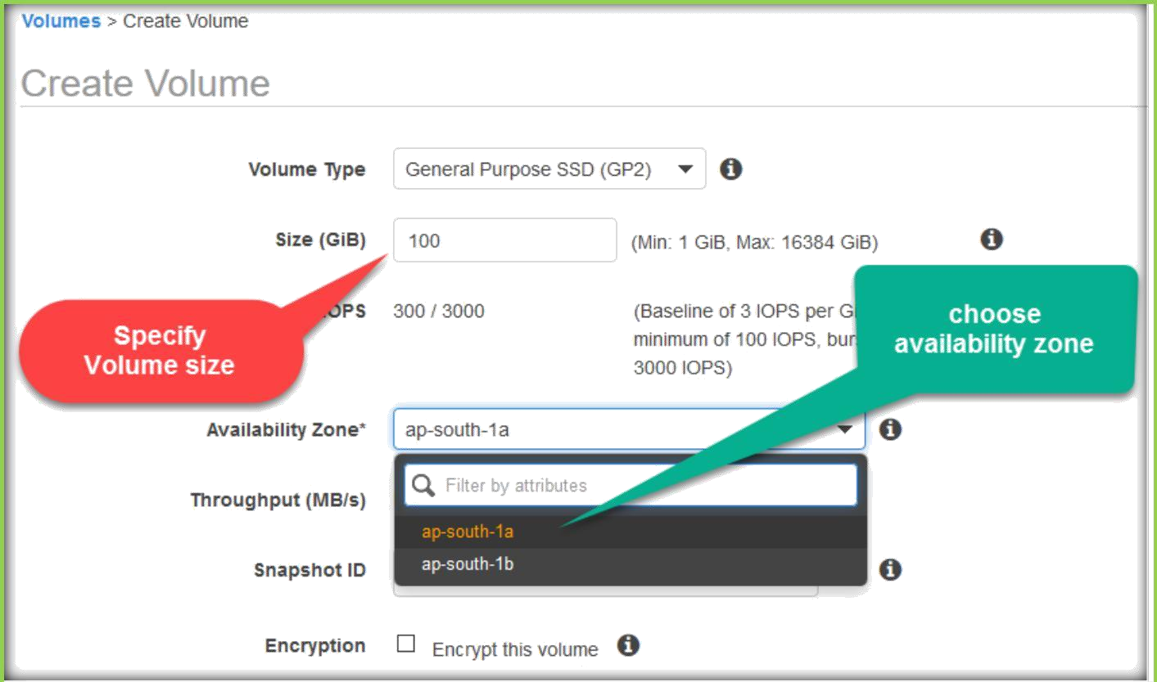
Specify volume size in GBs in Size text field and select availability zone from drop down list in which availability zone you want to create your volume.
Specify Snapshot ID if you want your new volume to be copied data from the snapshot, otherwise leave blank.
And select encrypt option if you want to encrypt your newly creating volume, otherwise leave un selected.

Slide 5
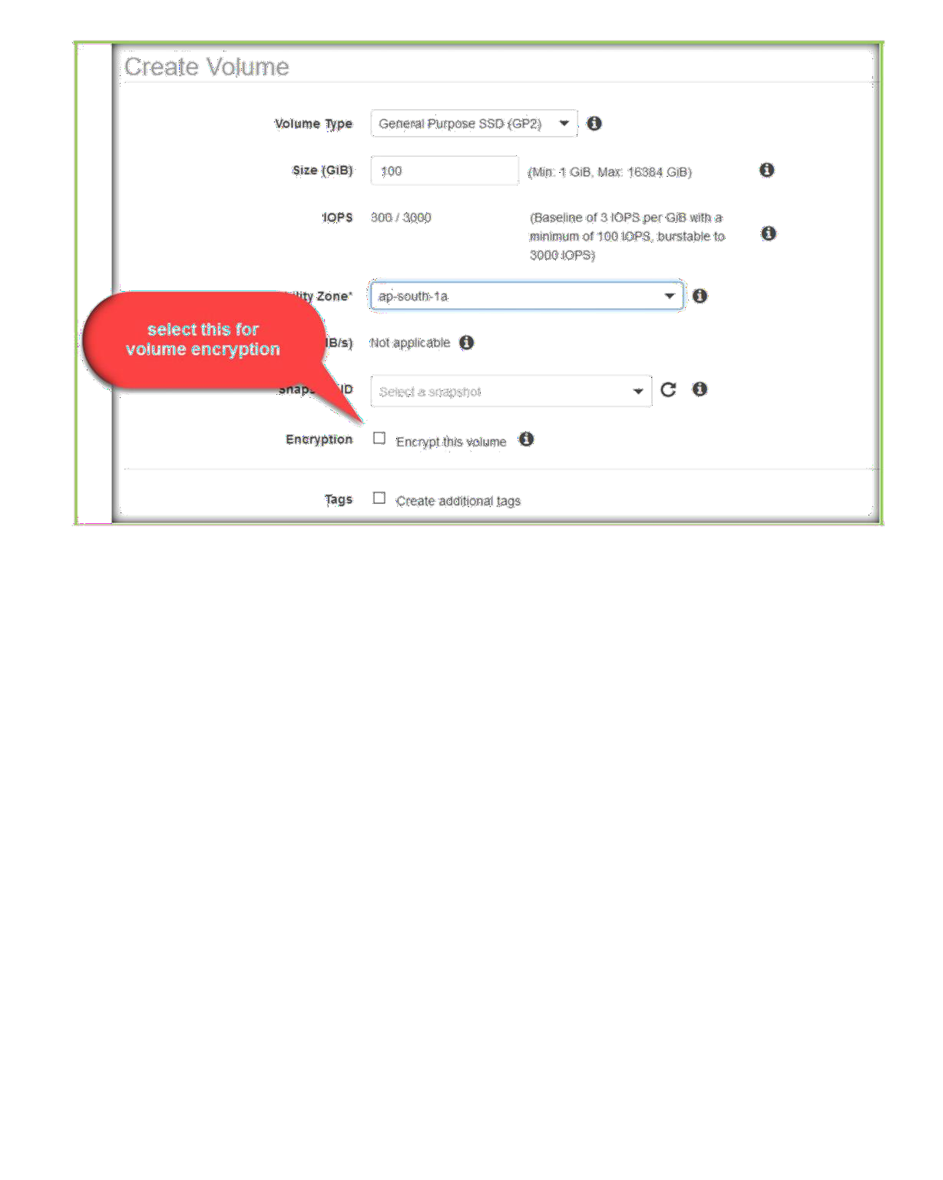
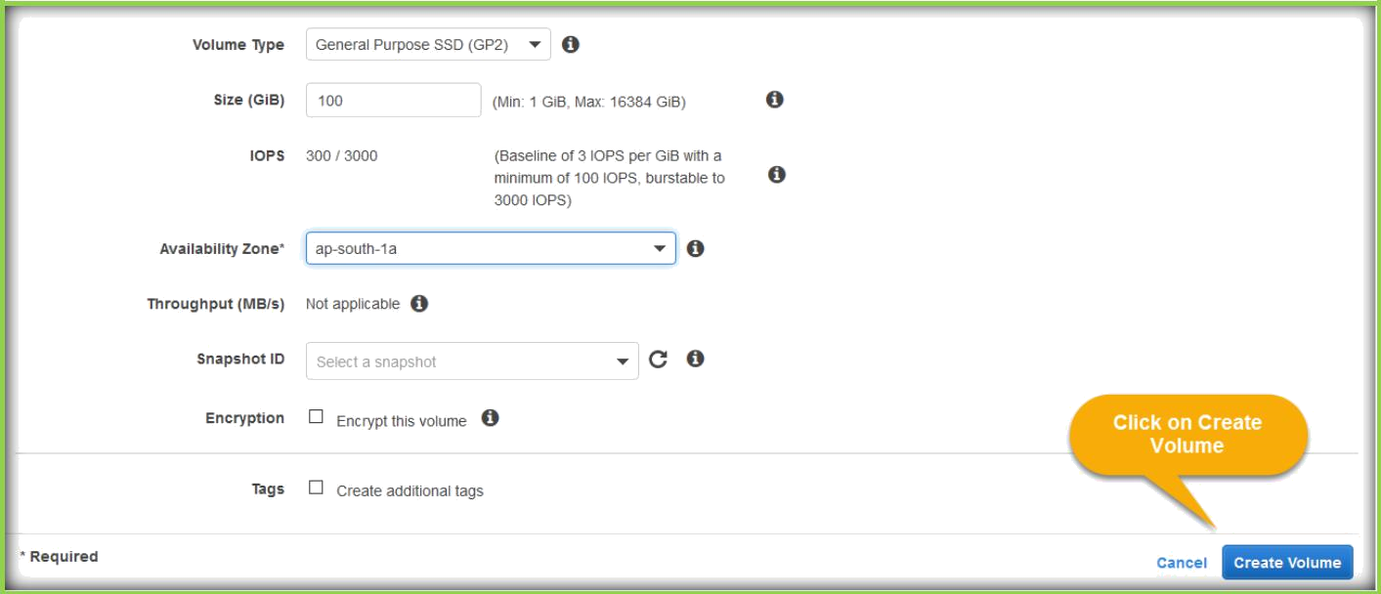
Then click on create after specifying the values required.

Slide 6
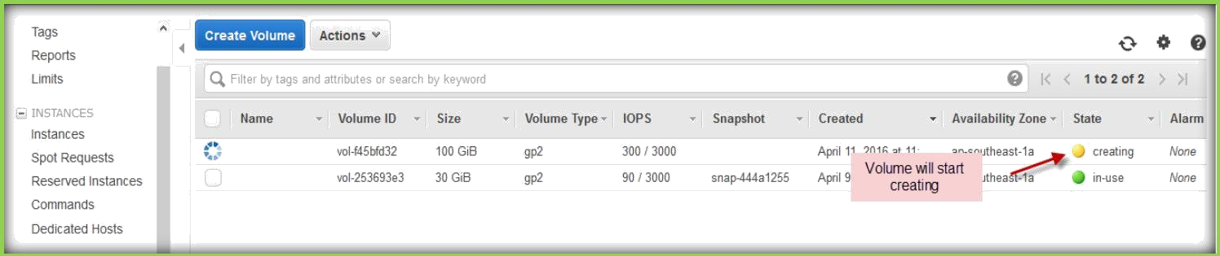
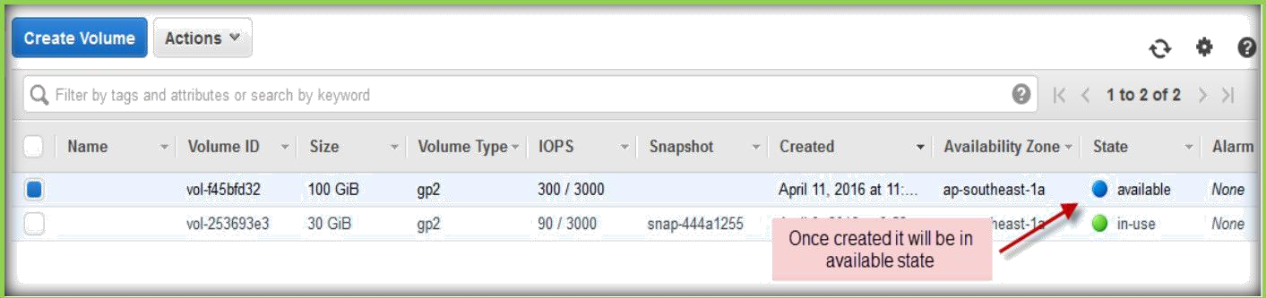
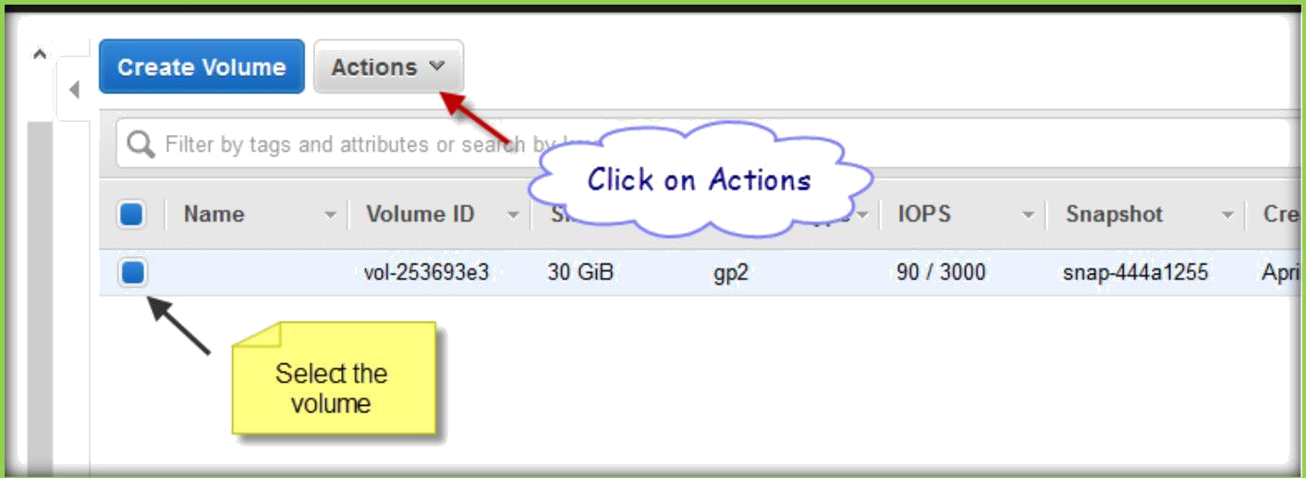
Your volume will start creating.
Once created it will be available state under volumes section.
DELETE EBS VOLUME
Once you logged in to AWS, go to EC2 section then go to Volumes section. Click the volume which you want to delete and click on actions.

Slide 7
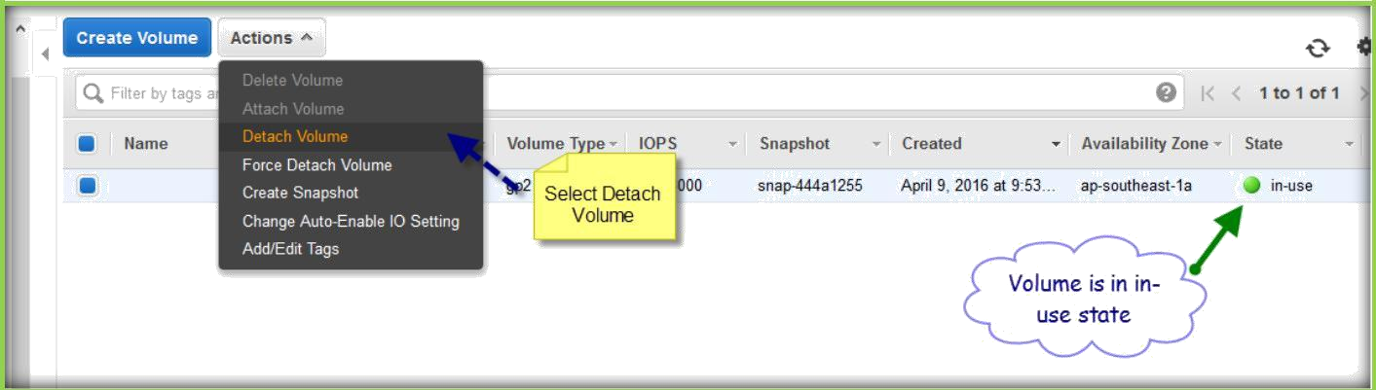
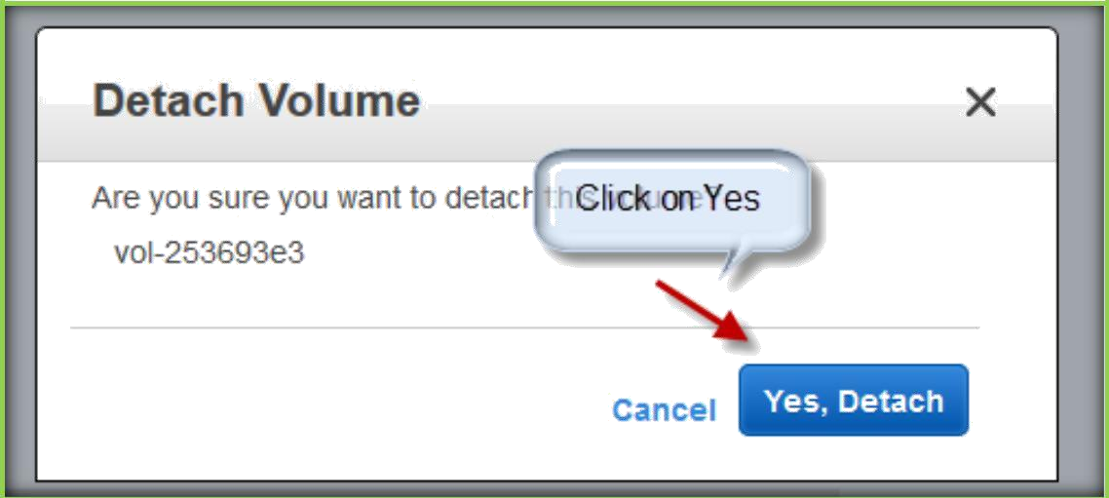
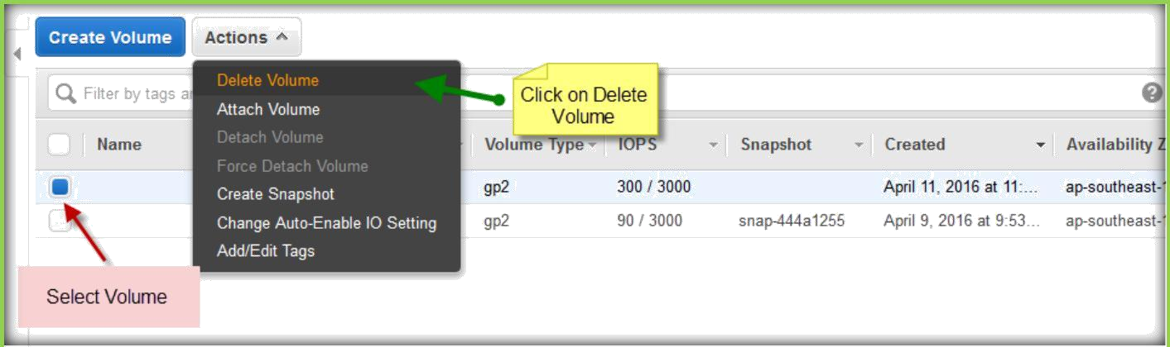
From the Actions menu select Detach Volume as you can see volume state is in in- use and those Delete volume option is un selectable.
Click on Yes, detach to detach volume from instance.
Select Volume which you want to delete then click on actions and select Delete Volume from the list.

Slide 8
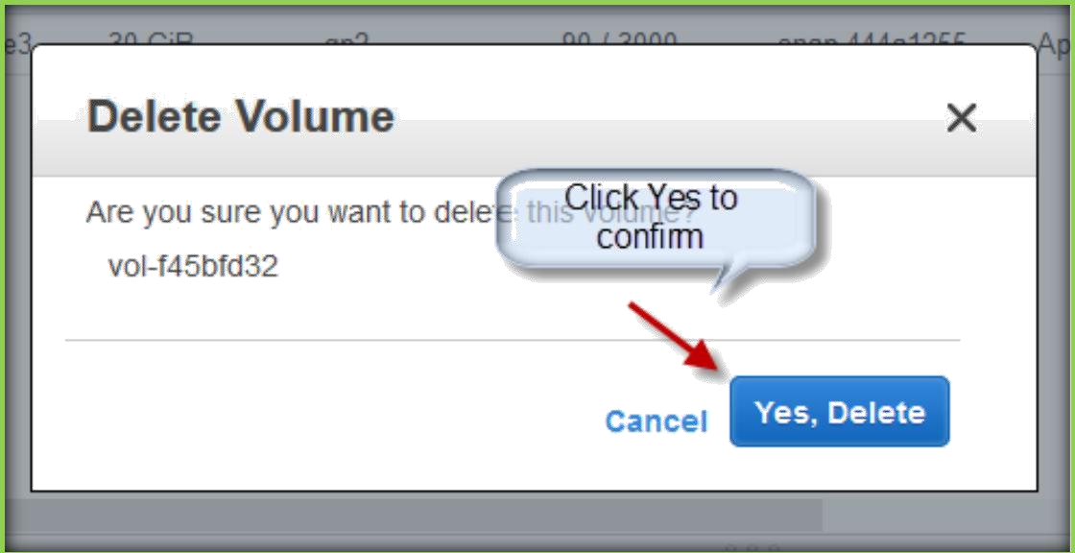
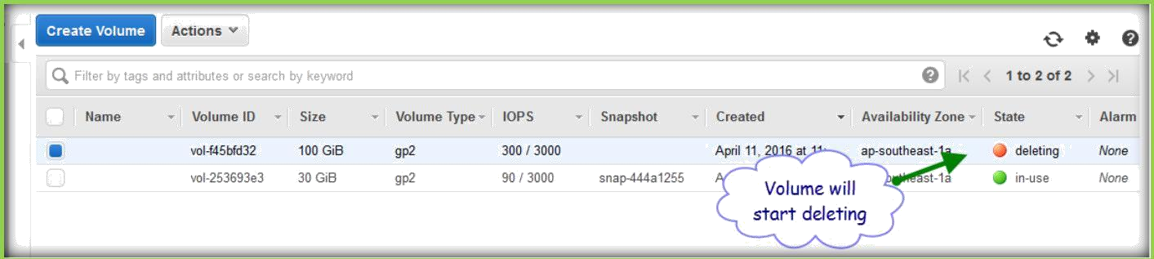
A pop-up window will come for confirmation, then click on Yes, delete to delete.
Volume will delete, and the State will change to deleting.
ATTACHING AND MOUNTING VOLUMES TO WINDOWS INSTANCES
Go to volumes section and create a volume, make sure you select the availability zone same as your instance is residing.
Once created select the Volume and click on actions and select Attach Volume.

Slide 9
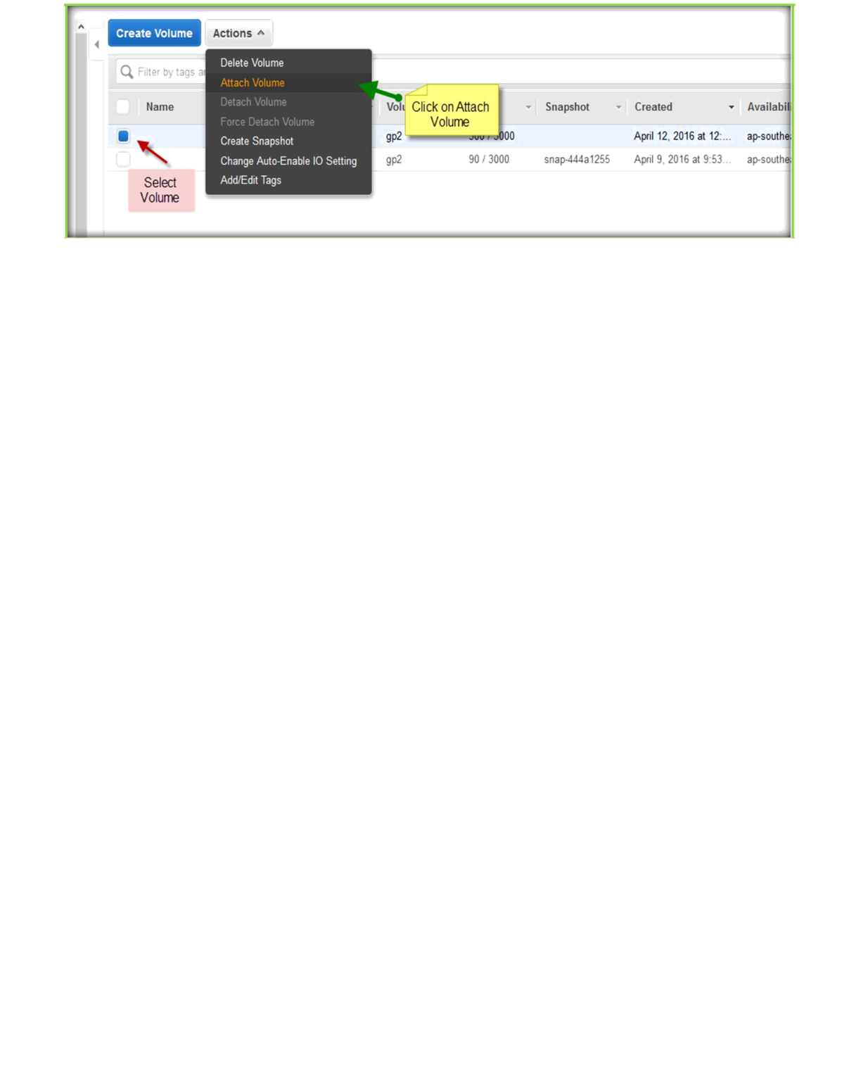
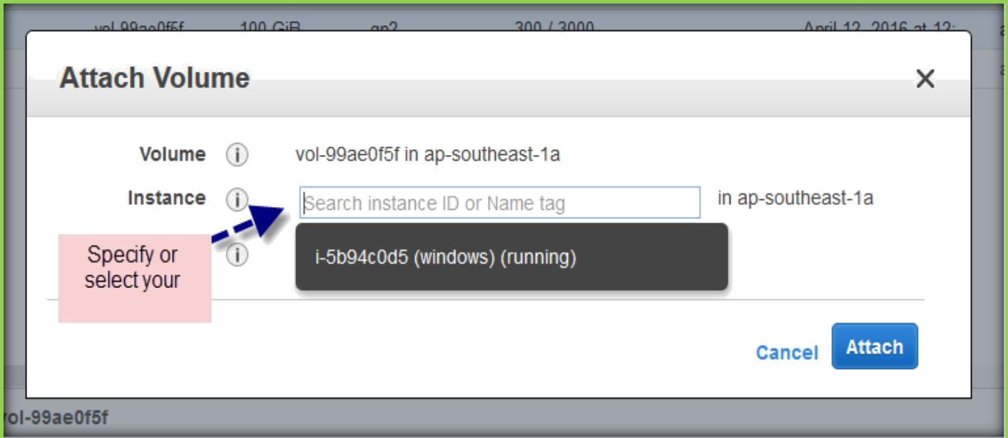
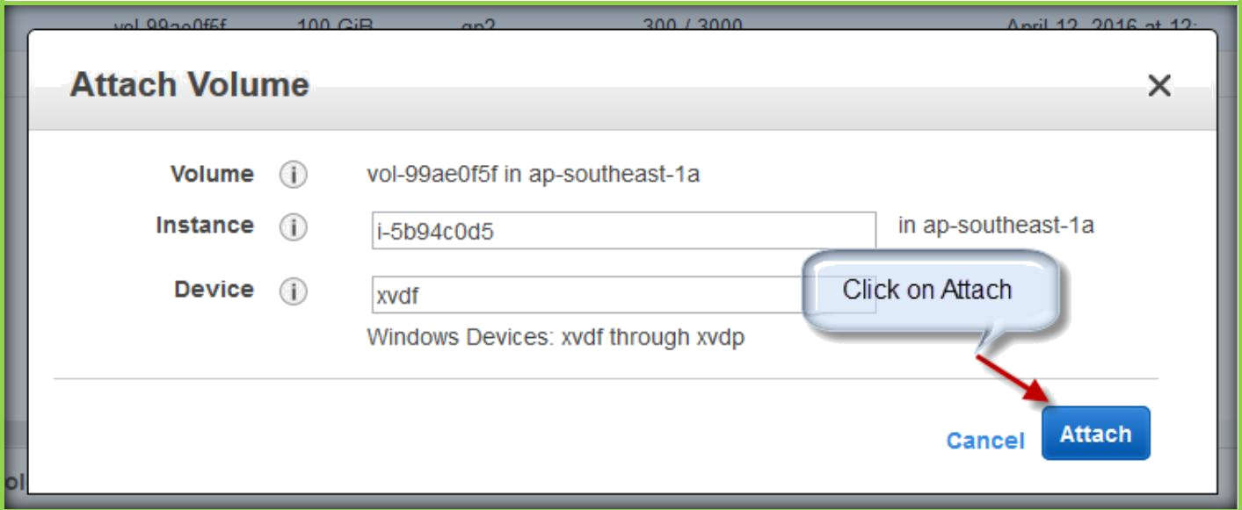
In the next page Select or search in the Instance text field and select your instance.
Then click on Attach button.

Slide 10
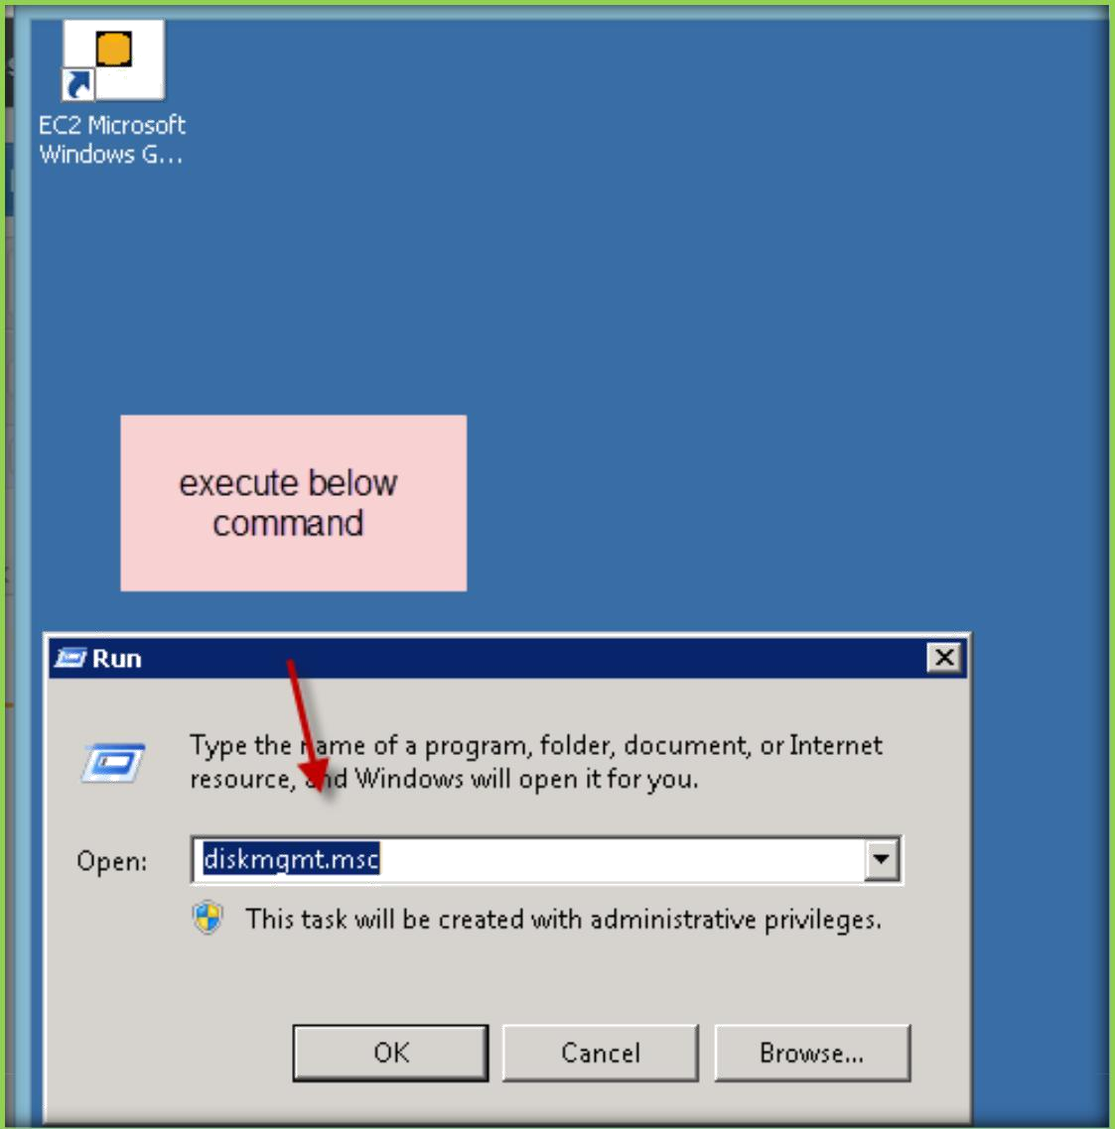
Then go and login to your instance, after logged in open Run and execute diskmgmt.msc command to open storage volumes attached to instance.
Then in the disk management screen select the volume which we have created and do a right click on the volume.

Slide 11
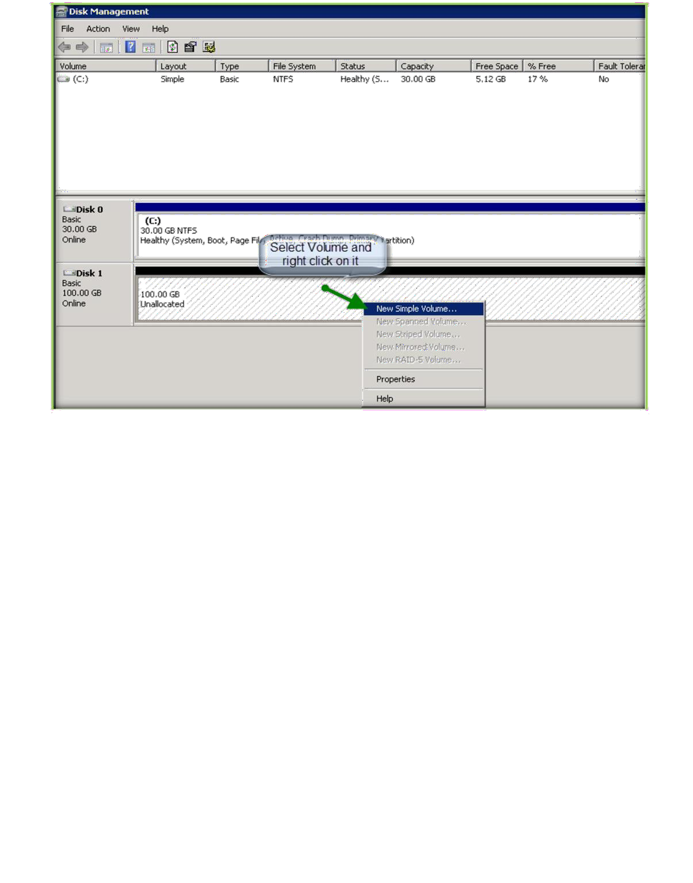

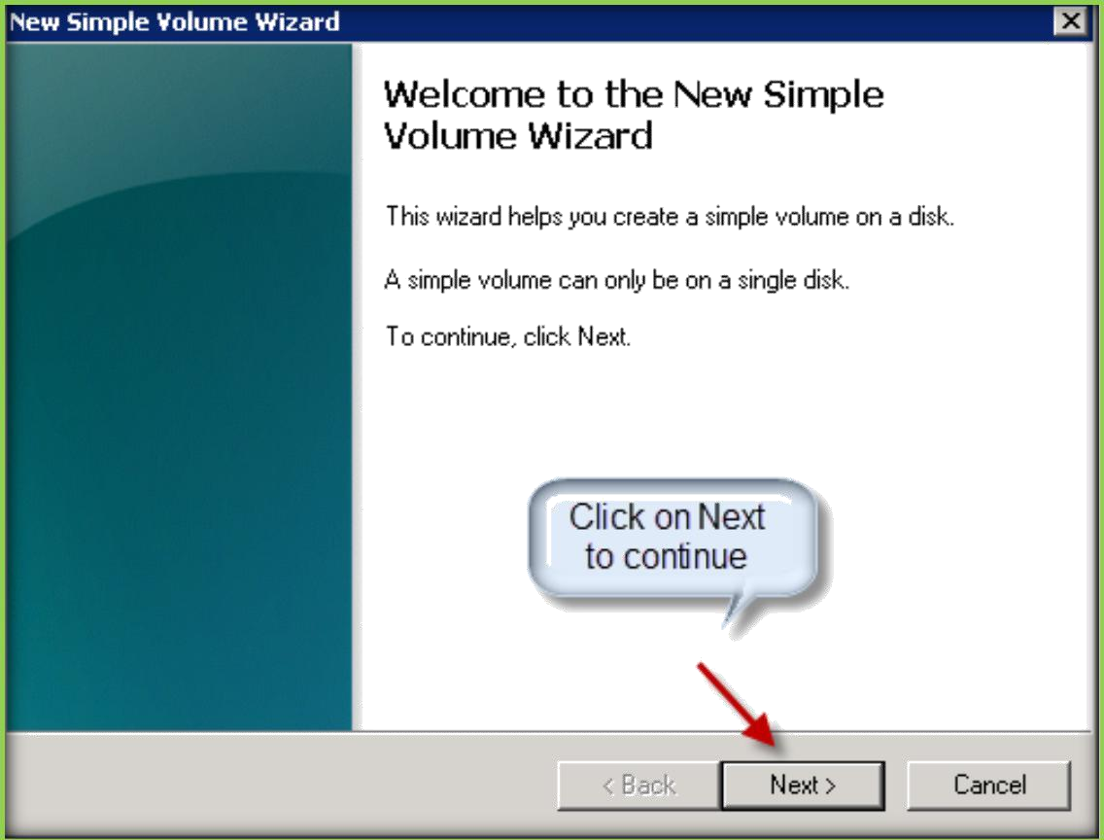
Click on Next to continue.

Slide 12
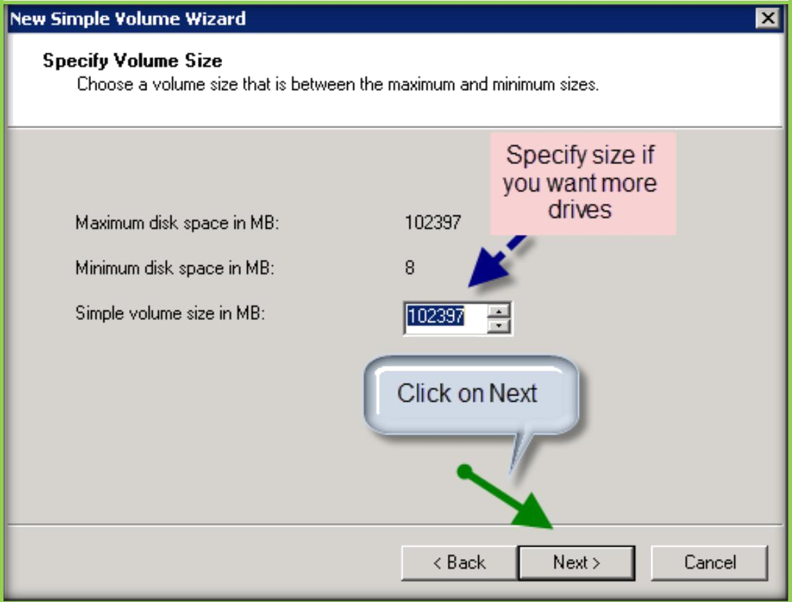
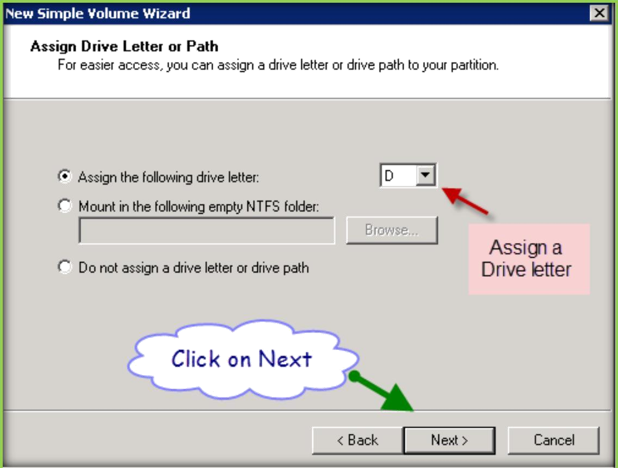
In the following screen specify size if you want to create more drives or leave as full size and click on Next.
Specify a drive for the newly creating volume and click on Next.

Slide 13
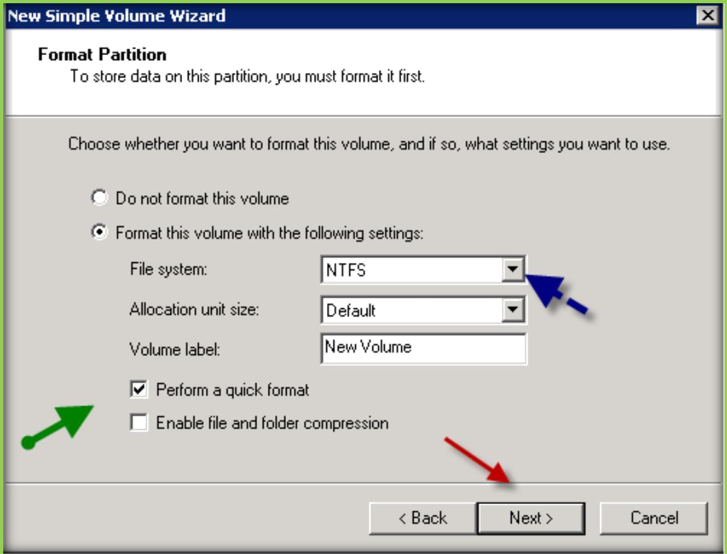
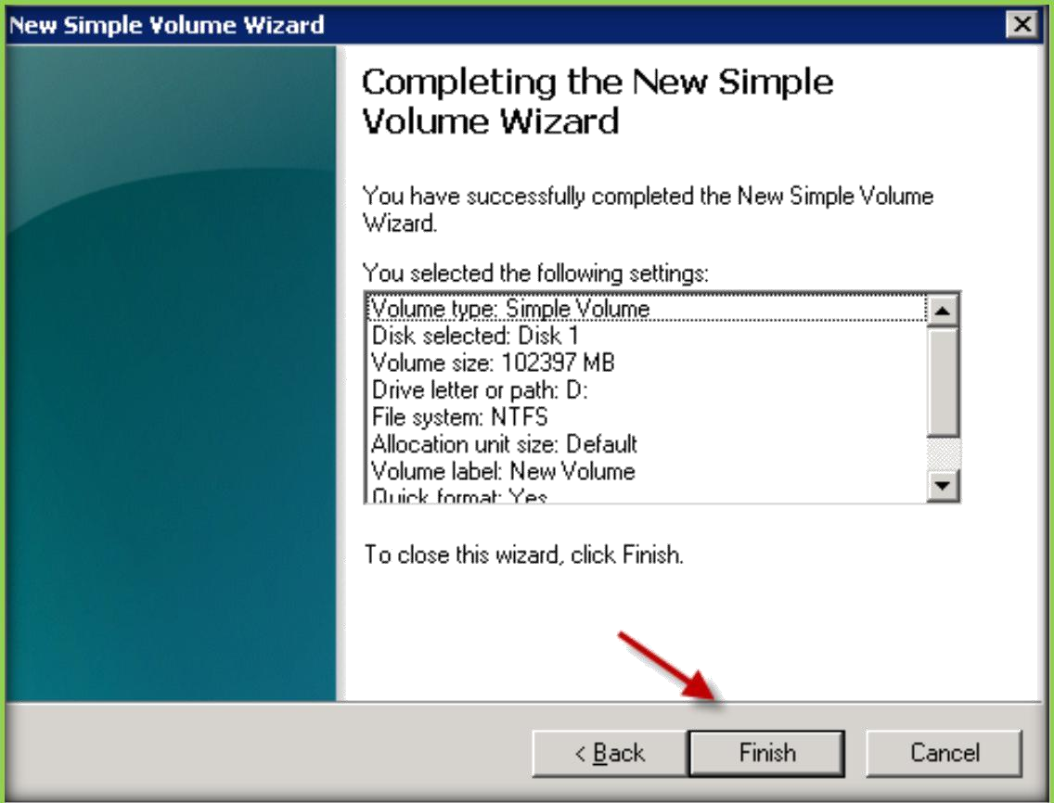
In the screen go with default selections and click on Next.
On the next screen click finish to complete the setup.

Slide 14
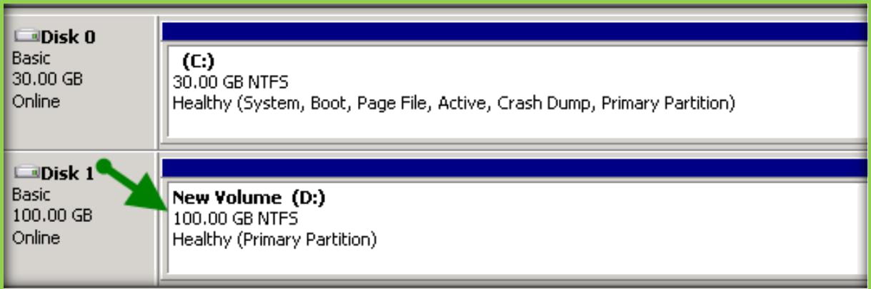
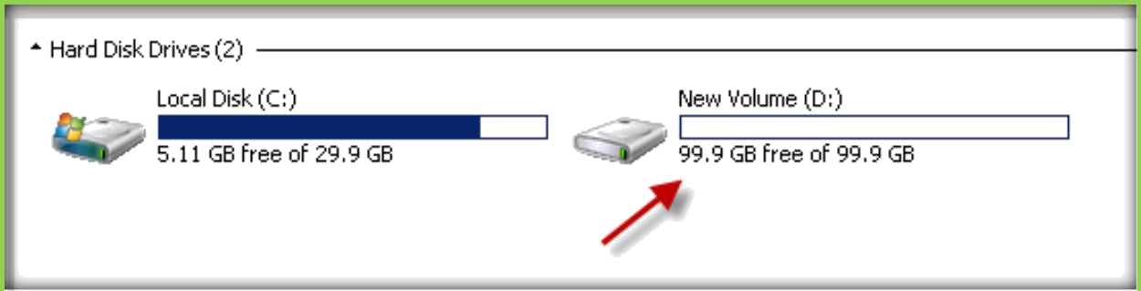
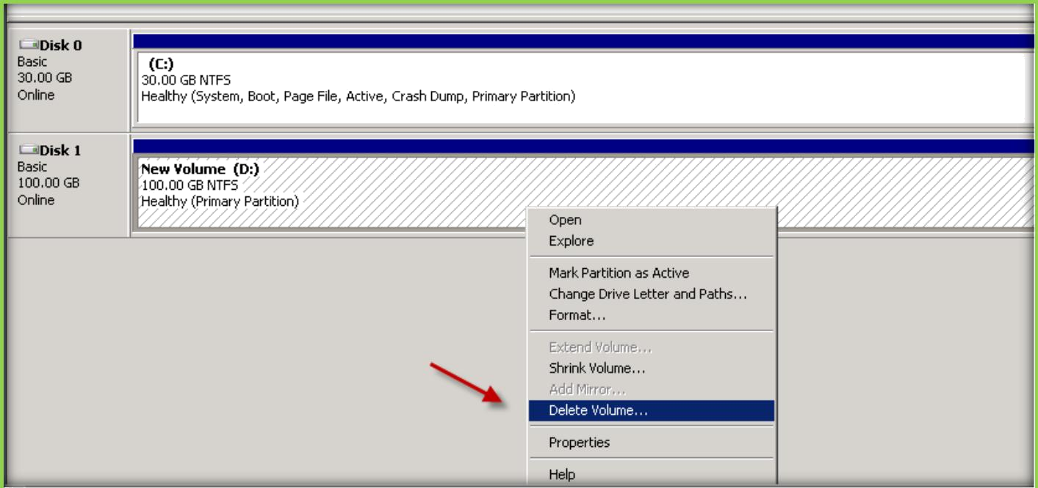
After formatting it will show as Healthy, then close disk management console.
Open My Computer to see the newly formatted volume.
To unmount the Volume, once again open run and execute diskmgmt.msc to disk management console.
Then select your volume and right click on it and select Delete Volume.

Slide 15
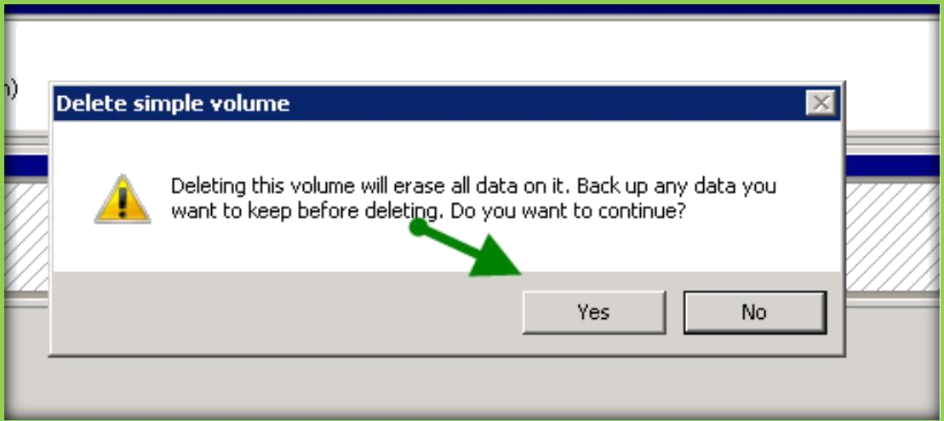
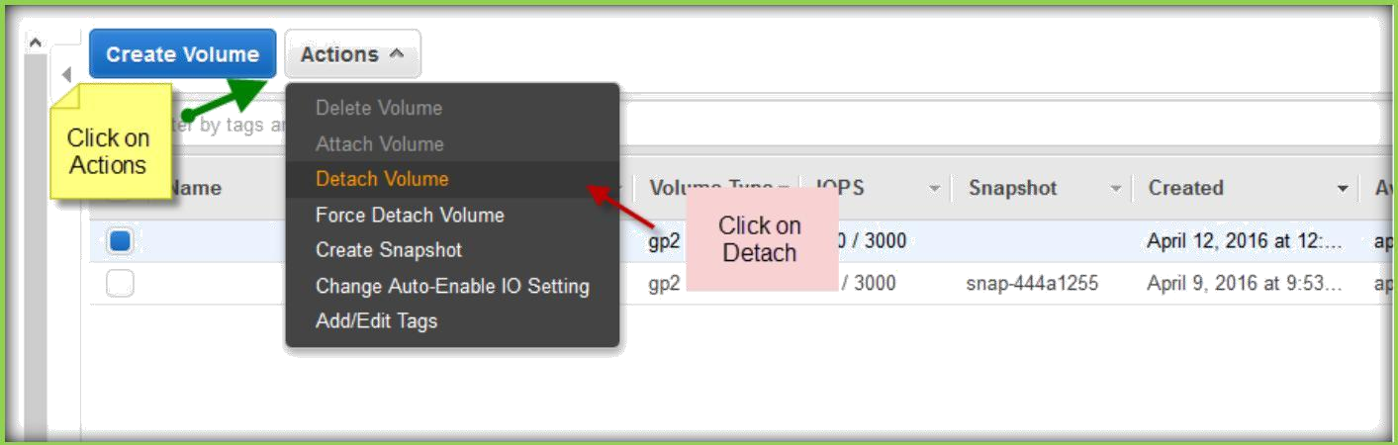
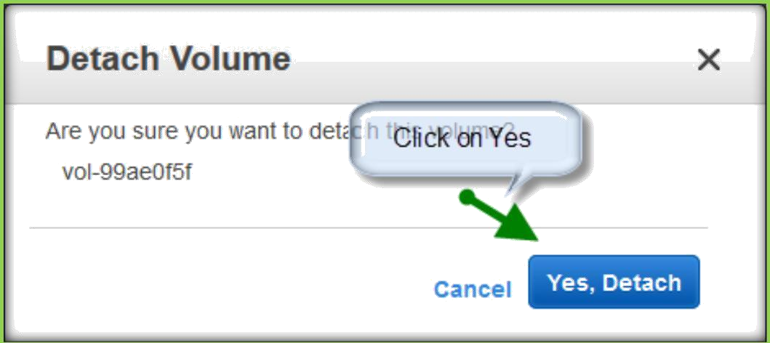
Click yes to confirm.
Then go to Volumes section on the EC2 page on AWS console. Select the volume and go to Actions click on Detach Volume.
Click on Yes, detach to confirming detaching from the Instance.

Slide 16
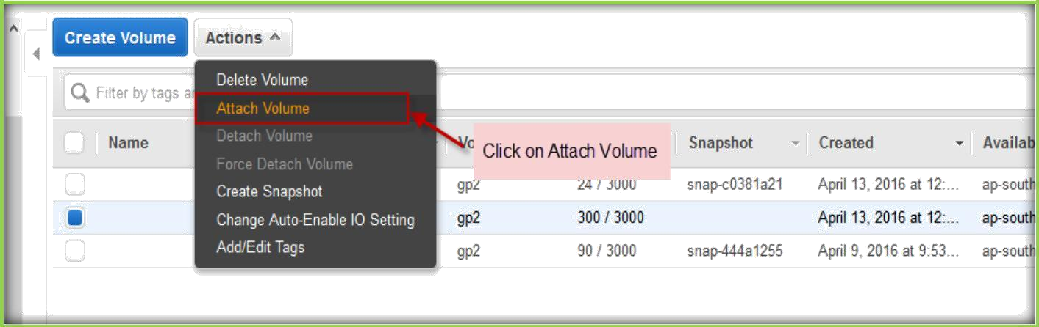
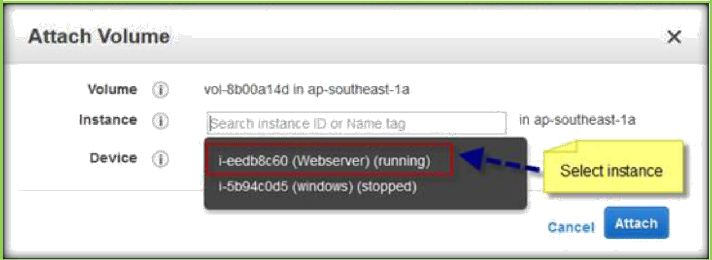
ATTACHING AND MOUNTING VOLUMES TO LINUX INSTANCES
Once you logged in to AWS, go Volumes section under EC2. Then create a volume as depicted above.
Once created select the volume and click Actions and choose Attach Volume.
Select instance from the Instance text field or specify Instance id.
Then click on Attach to attach volume to selected instance.

Slide 17
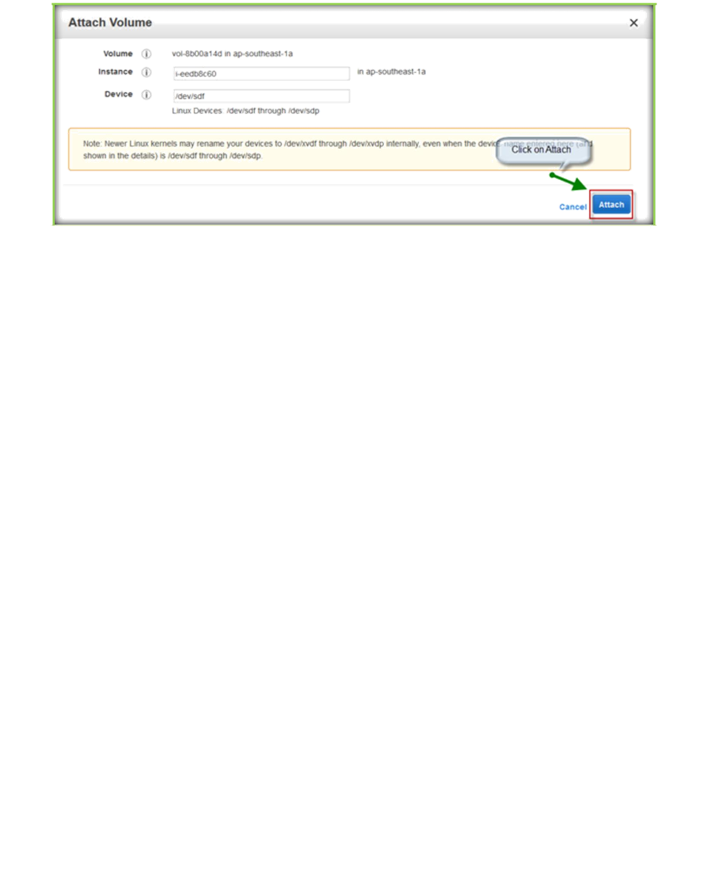
Then go and login to Linux and execute the below commands to format and mount to your instance.
Create the partition for newly attached volume. [root@ip-172-31-25-51 ~]# fdisk /dev/xvdf Welcome to fdisk (util-linux 2.23.2).
Changes will remain in memory only, until you decide to write them. Be careful before using the write command.
Device does not contain a recognized partition table
Building a new DOS disklabel with disk identifier 0x7ee209a3.
Command (m for help): n Partition type:
p primary (0 primary, 0 extended, 4 free) e extended
Select (default p):
Using default response p Partition number (1-4, default 1):
First sector (2048-209715199, default 2048):
Using default value 2048
Last sector, +sectors or +size{K,M,G} (2048-209715199, default 209715199): Using default value 209715199
Partition 1 of type Linux and of size 100 GiB is set
Command (m for help): p

Slide 18
Disk /dev/xvdf: 107.4 GB, 107374182400 bytes, 209715200 sectors Units = sectors of 1 * 512 = 512 bytes

Slide 19
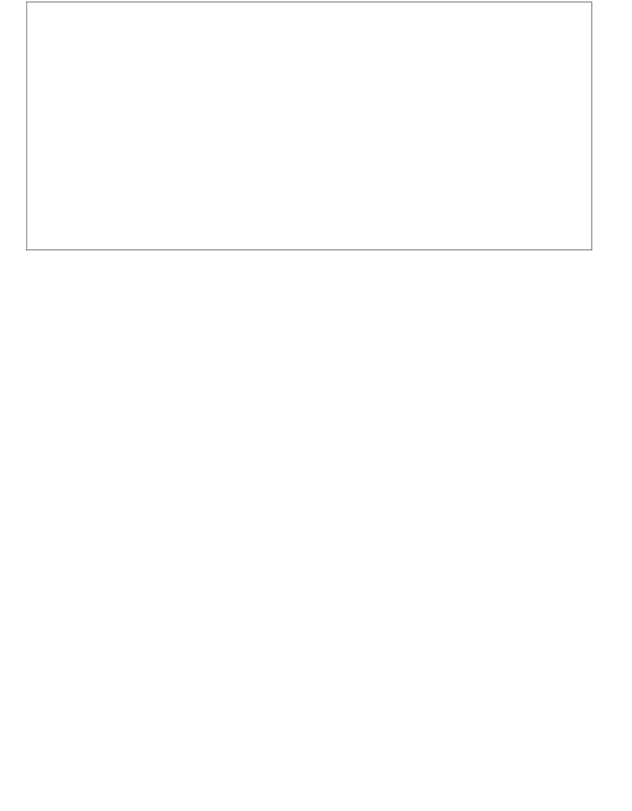
Sector size (logical/physical): 512 bytes / 512 bytes I/O size (minimum/optimal): 512 bytes / 512 bytes Disk label type: dos
Disk identifier: 0x7ee209a3
Device Boot
/dev/xvdf1
Start End Blocks Id System 2048 209715199 104856576 83 Linux
Command (m for help): w
The partition table has been altered!
Calling ioctl() to re-read partition table. Syncing disks.
Formatting newly creat |  |  | ed partition. ~]# mkfs.ext4 /dev/xvdf1 -2014) 26214144 4k blocks and 6553600 6459b7c0-440f-4fc0-9422- ck backups stored on blocks: 40, 229376, 294912, 819200, 884736, 1605632, 2654208, 11239424, 20480000, 23887872 done e blocks): done filesystem accounting information: done now mounting to a directory. ~]# mount /dev/xvdf1 /mnt/
[root@ip-172-31-25-51
mke2fs 1.42.12 (29-Aug
Creating filesystem with
inodes Filesystem UUID:
94de2ee5dc34 Superblo
32768, 98304, 1638
4096000, 7962624,
Allocating group tables:
Writing inode tables: don
Creating journal (32768
Writing superblocks and
Once formatted, we are
[root@ip-172-31-25-51
[root@ip-172-31-25-51 |  |  | ~]# df -h
Filesystem | Size Used Avail Use% Mounted on
/dev/xvda1 | 7.8G 1.1G 6.6G 15% /
devtmpfs | 490M | 64K 490M 1% /dev
tmpfs | 498M | 0 498M 0% /dev/shm

Slide 20
/dev/xvdf1 | 99G | 60M 94G 1% /mnt

Slide 21
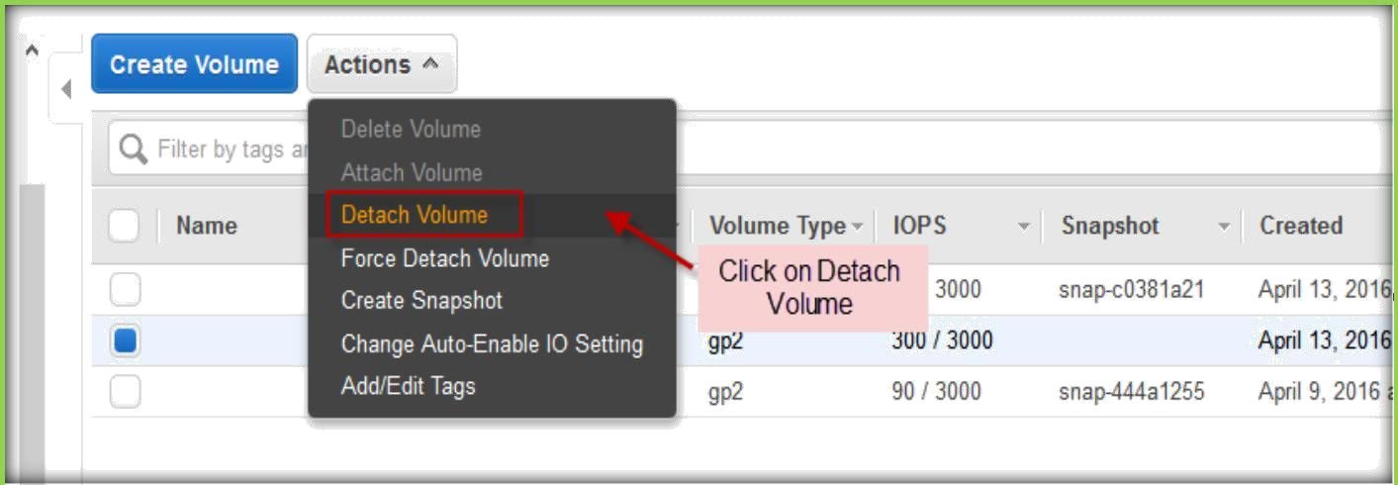
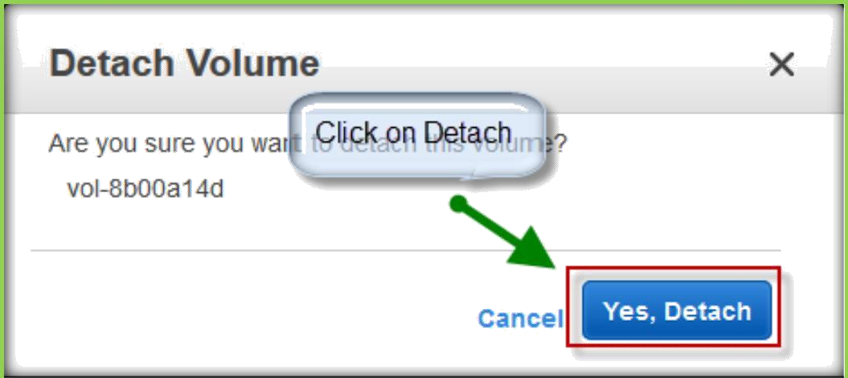
To unmount from the instance, follow below process.
[root@ip-172-31-25-51 ~]# umount /mnt/ [root@ip-172-31-25-51 ~]# df -h
Filesystem | Size Used Avail Use% Mounted on
/dev/xvda1 | 7.8G 1.1G 6.6G 15% /
devtmpfs | 490M | 64K 490M 1% /dev
tmpfs | 498M | 0 498M 0% /dev/shm
After unmounting, go to Volumes section, select the volume and click on Actions. Under the Actions, click on Detach Volume.
Click on Yes, detach to detach volume.

Slide 22
Once Volume detached, you can select and delete the volume.

Slide 23
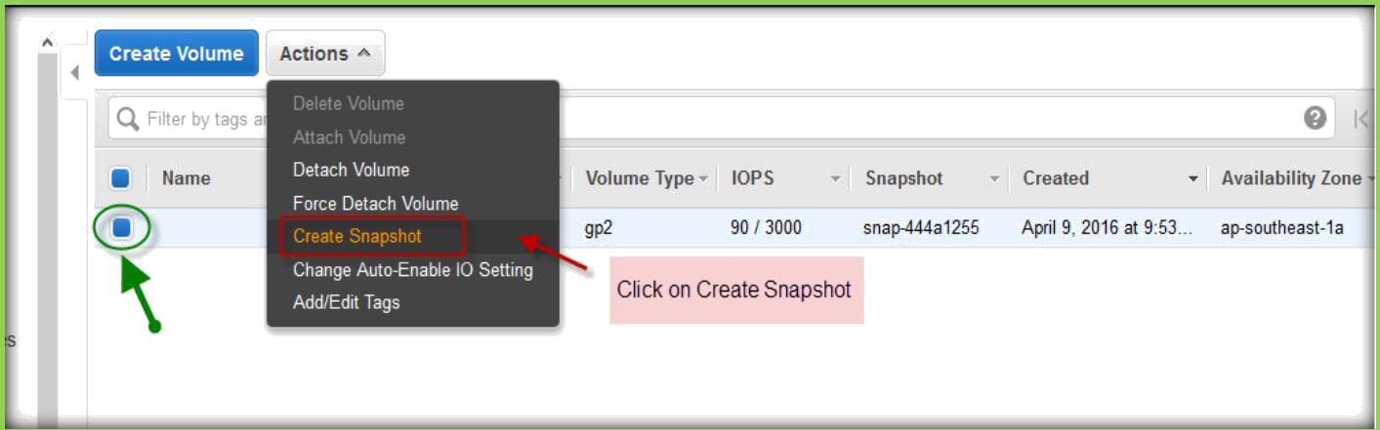
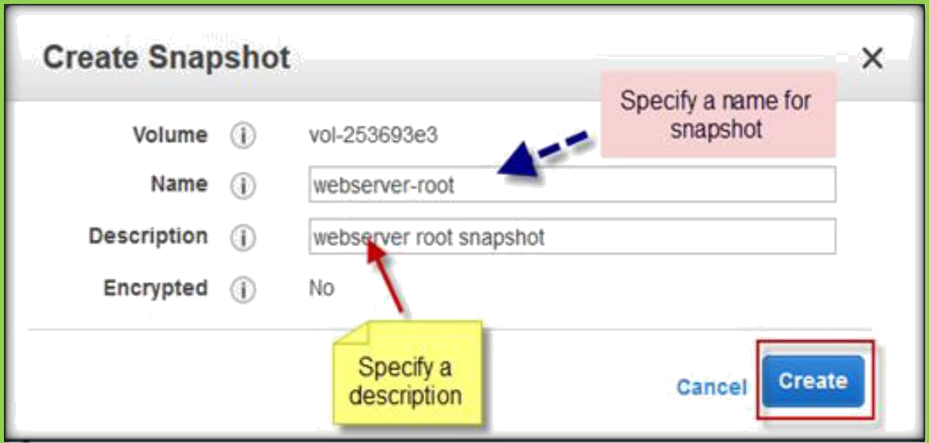
CREATING AND DELETING SNAPSHOTS
Go to Volumes section under EC2 on AWS console.
Select the volume which you want to take a snapshot and click on Actions. Under Actions menu, select Create Snapshot.
In the next page specify name for snapshot and add description, click on Create button to create.
A confirmation box will pop up with Snapshot id.

Slide 24
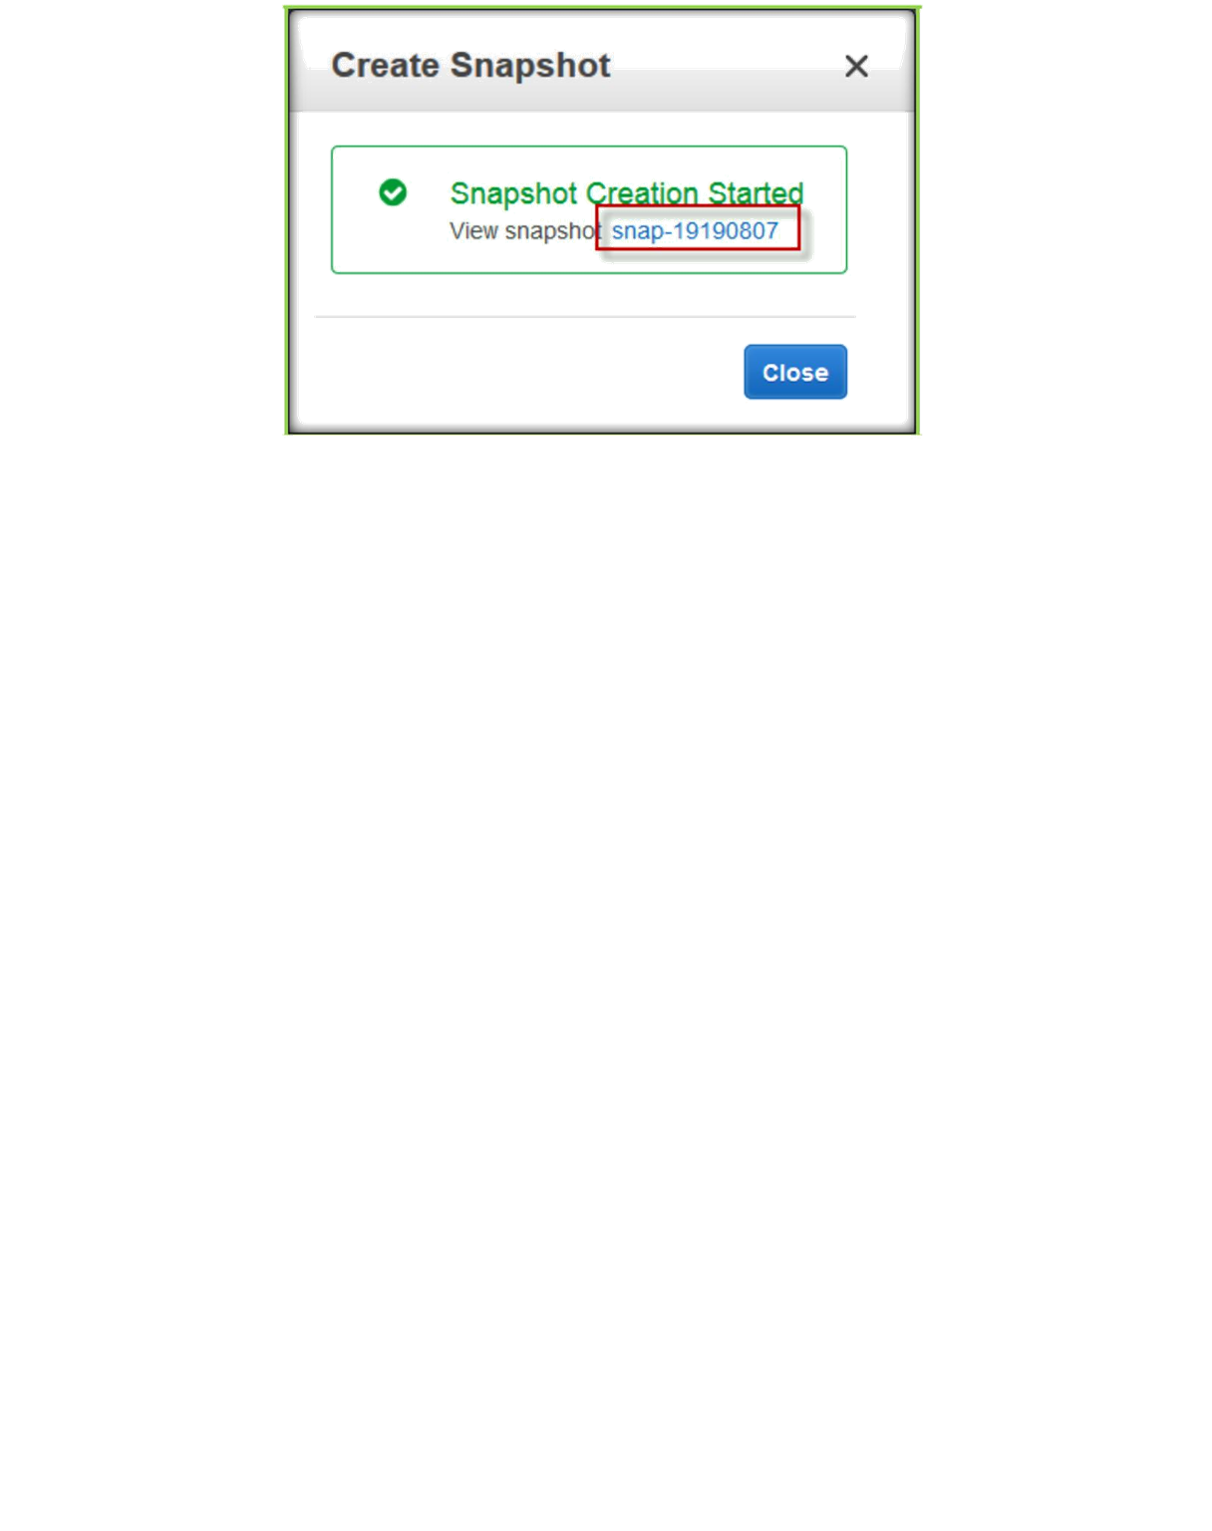
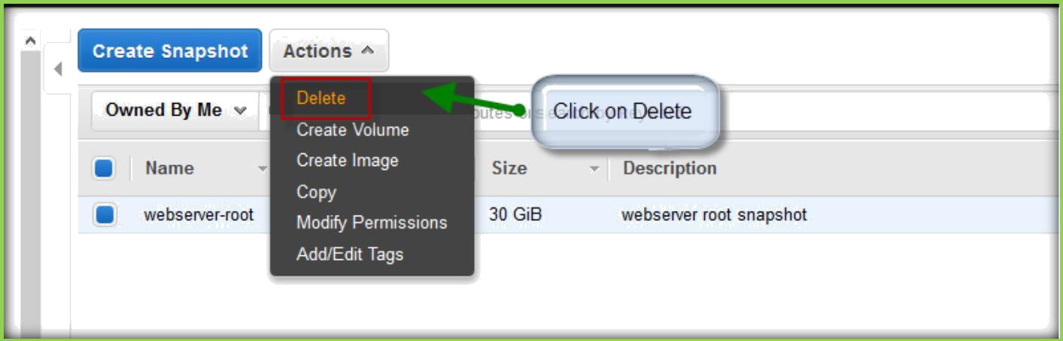
Click on the snapshot id to go the snapshot section or go to Snapshots under ELASTIC BLOCK STORE on EC2 left pane. You will find your snapshot which is created.
DELETING SNAPSHOTS
Go to Snapshots section under EC2 page, then select your snapshot which you want to delete.
Click on Actions, select Delete to delete the snapshot.

Slide 25
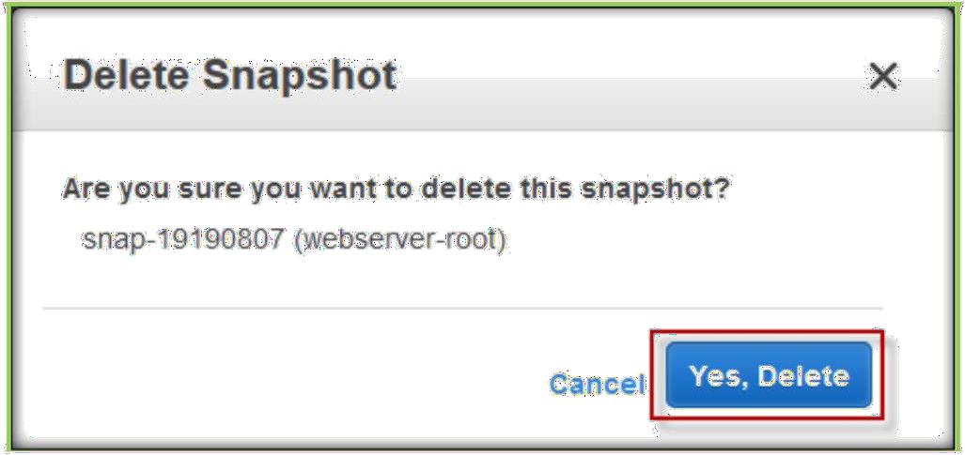
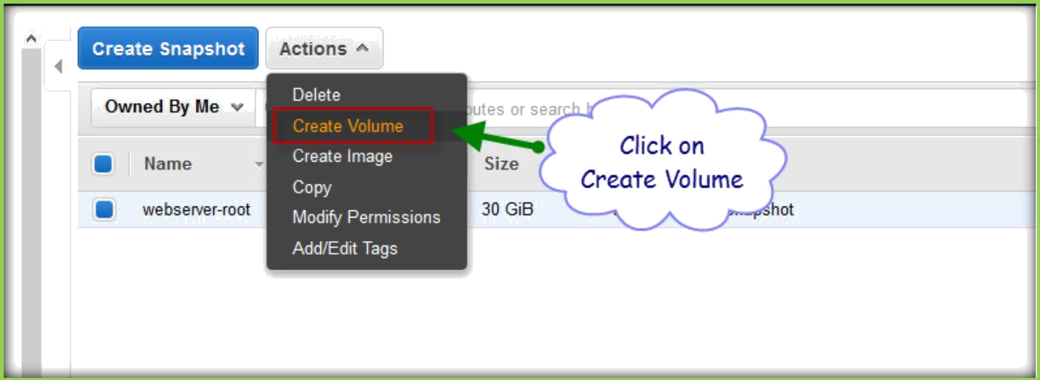
A confirmation dialog popup will show, click on Yes, delete to delete the snapshot.
CREATING VOLUMES FROM SNAPSHOTS
Go to Snapshots section under EC2 page.
Select the snapshot and click on Actions, then select Create Volume to create a new volume.

Slide 26
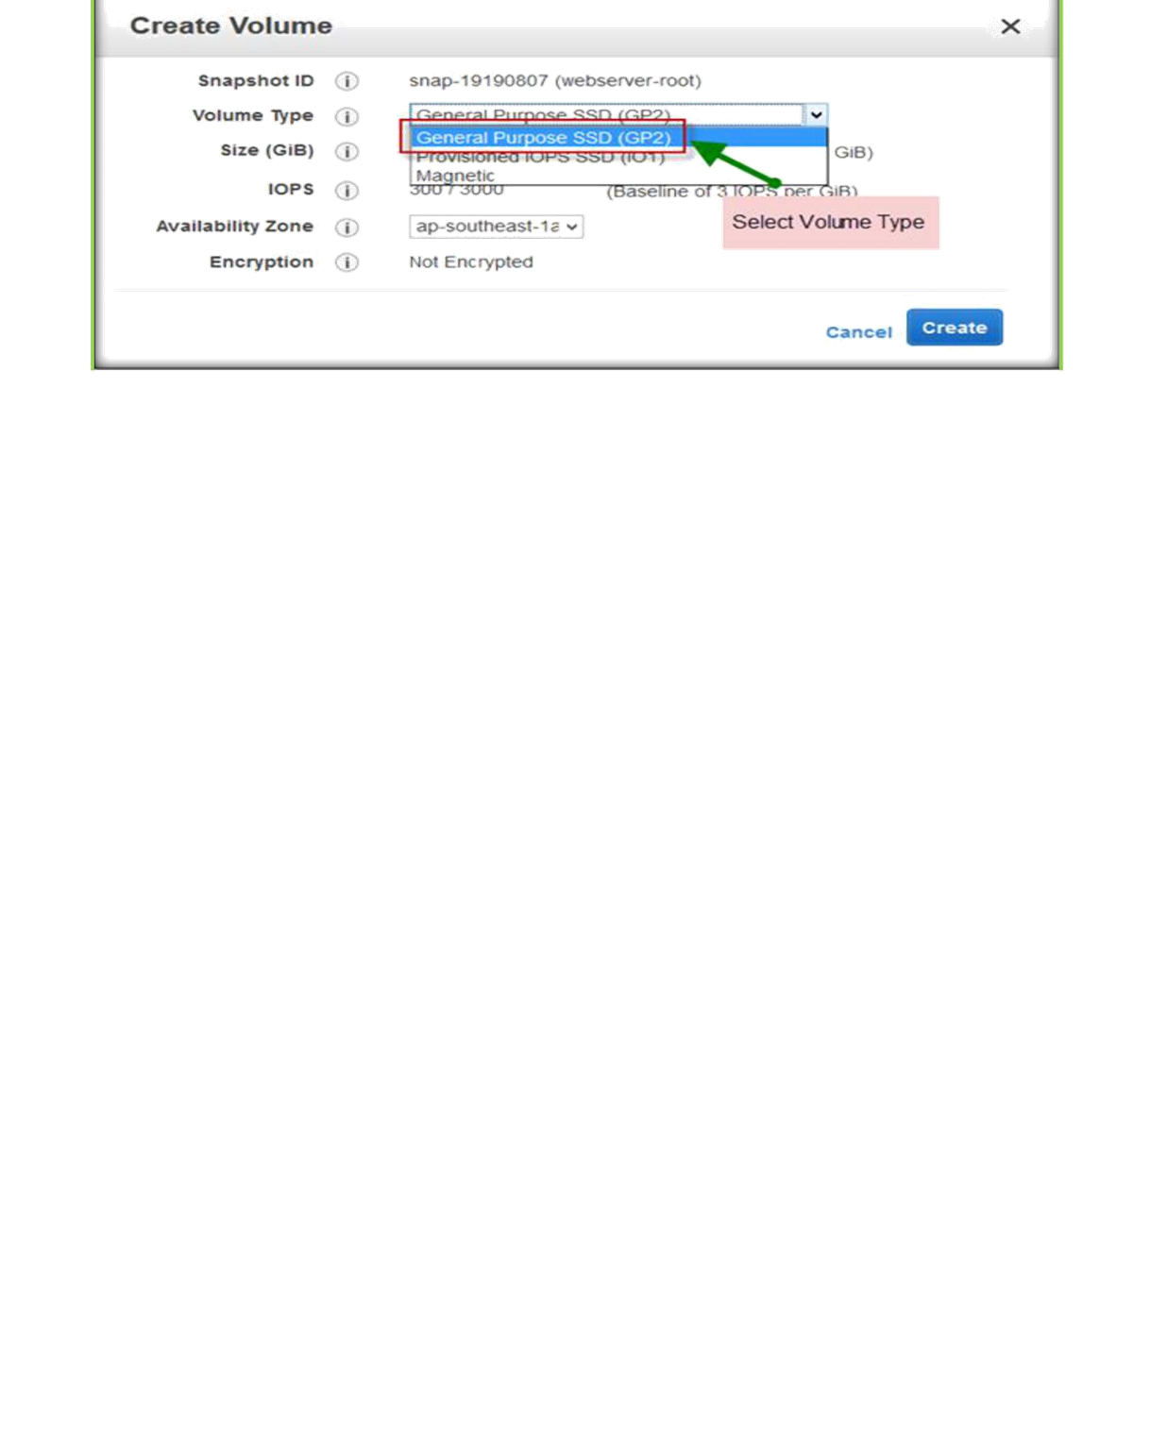
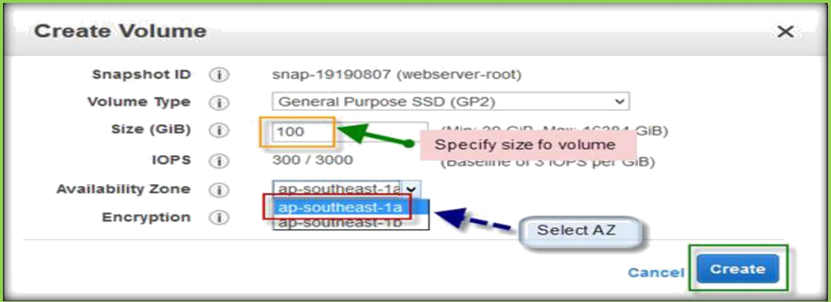
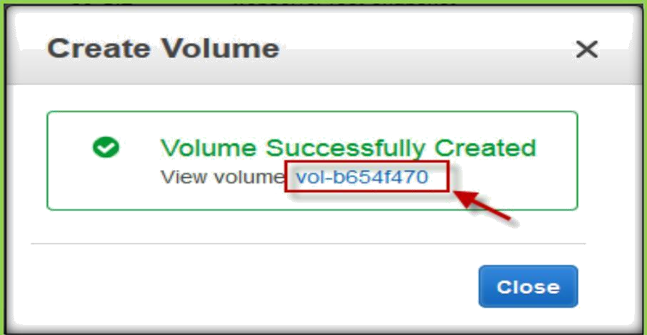
In the next page, select the Volume Type from the drop-down list.
Specify size in size text field, select availability zone from drop down list. Then click on create button to create a volume.
A confirmation pops up with volume id will show, click on volume id to go to the volume.
After creation volume, you can attach to other instances.

Slide 27
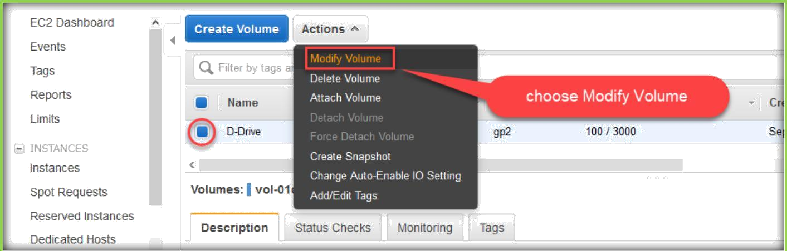
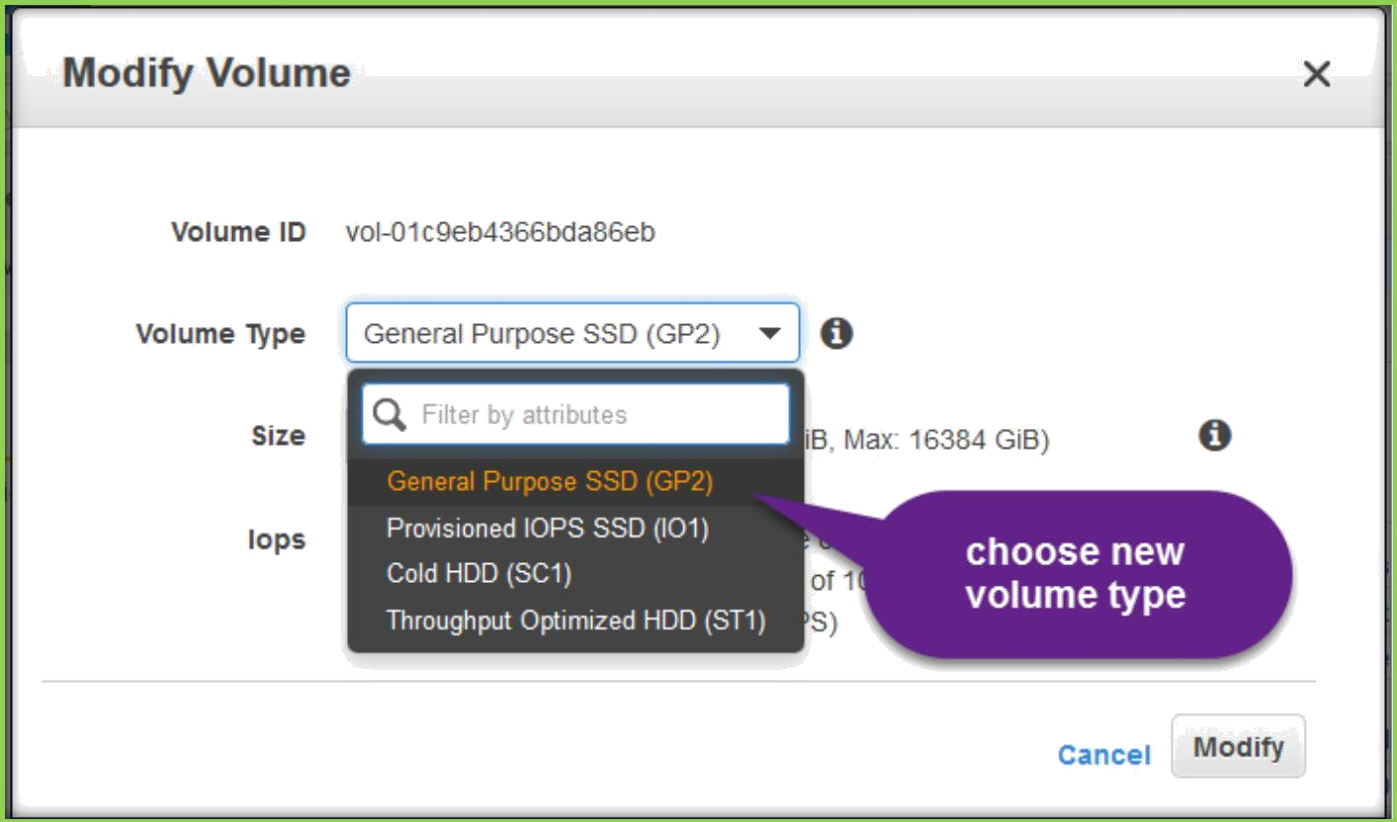

MODIFY VOLUMES
Amazon EBS volume is attached to an EC2 instance type, can increase its size, change its volume type, or (for an io1 volume) adjust its IOPS performance, all without detaching it. You can apply these changes to detached volumes as well.
Go to volumes, choose the volume which you want to modify, then select and go to Actions tab then choose modify volume.
On the modify volume dialog box, choose a different volume type if you want to change to a new volume type.

Slide 28
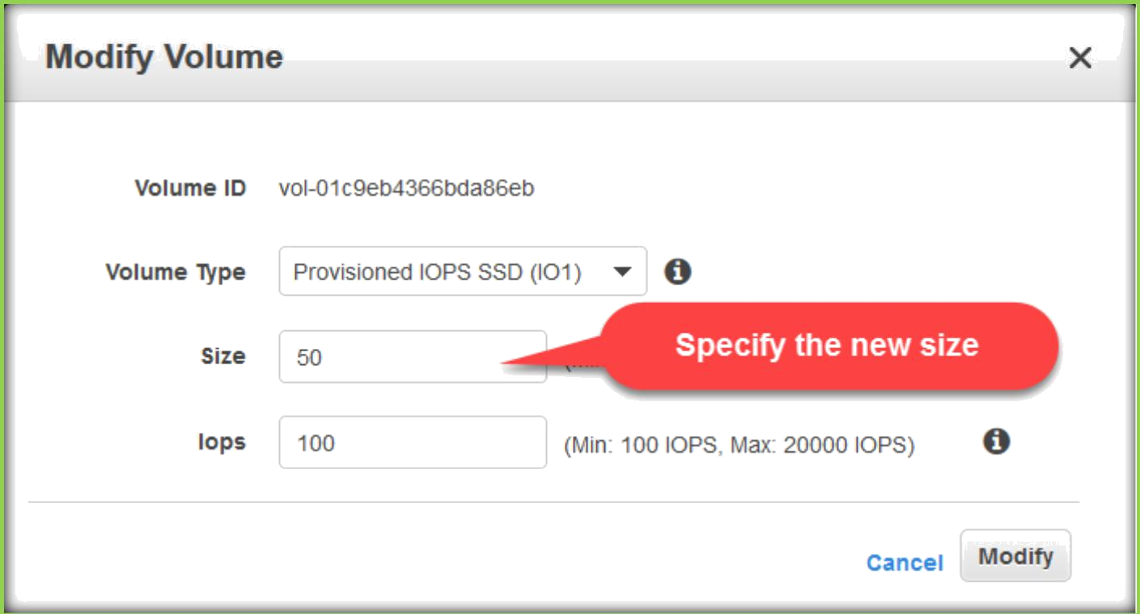
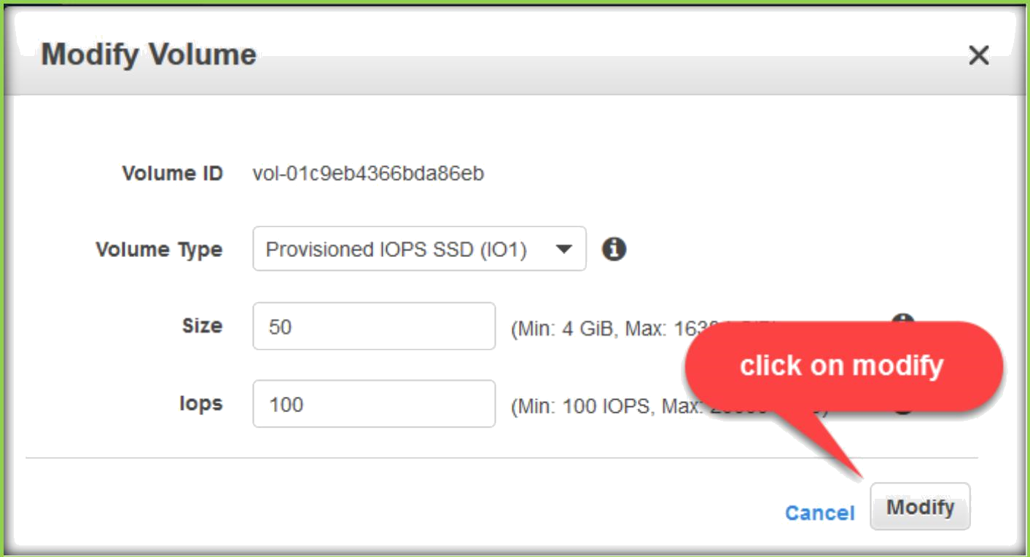
Specify the new size and IOPS if it is Provisioned IOPS volume.
Then click on modify.

Slide 29



You can view the volume state about the modification.
Once done state will show completed.
Then we must go to the respective operating system and extend the volume sizes to view the new size in the operating systems.
Creating and Using a Lifecycle Policy
Lifecycle Manager uses lifecycle policies to figure out when to run, which volumes to snapshot, and how long to keep the snapshots around.
I access the Lifecycle Manager from the Elastic Block Store section of the menu

Slide 30

Then I click Create Snapshot Lifecycle Policy to proceed:
Then I create my first policy

Slide 31


Slide 32


I use tags to specify the volumes that the policy applies to. If I specify multiple tags, then the policy applies to volumes that have any of the tags
I can create snapshots at 12- or 24-hour intervals, and I can specify the desired snapshot time. Snapshot creation will start no more than an hour after this time, with completion based on the size of the volume and the degree of change since the last snapshot.
I can use the built-in default IAM role or I can create one of my own. If I use my own role, I need to enable the EC2 snapshot operations and all the DLM (Data Lifecycle Manager) operations.
Newly created snapshots will be tagged with the aws: dlm:lifecycle- policy-id and aws:dlm:lifecycle-schedule-nameautomatically; I can also specify up to 50 additional key/value pairs for each policy

Slide 33

I can see all my policies at a glance

Slide 34

I took a short break and came back to find that the first set of snapshots had been created, as expected (I configured the console to show the two tags created on the snapshots)

